Slide 1
IT3081 Statistical Modelling
Road Accident Severity Prediction
Statistical modeling approach to identify Road accidents
2026-DS-21 | Industry / Organization | Presenter Names

Slide 2
Presentation Flow
02
Presentation Roadmap
Industry Problem & Consultancy Objectives
Research Landscape & Gap
Dataset Selection & Understanding
Descriptive Analysis & Initial Insights
Statistical Inference Evidence
Predictive Statistical Modelling
Experimental Design Evaluation
8. PCA Evaluation
9. Bayesian Statistical Methods
10.Time Series Extension
11.Industry Innovation Proposal
12.Industry Expert Validation
13.Final Consultancy Recommendations
IT3081 Statistical Modelling · Consultancy Presentation

Slide 3
Task 1
03
Industry Problem & Consultancy Objectives
Industry: Road Transport & Public Safety (UK DfT)
Problem:
- 106,000 road collisions in 2022
- 1,700 fatalities, ~25,000 serious injuries
£34 billion annual societal cost
Limited predictive tools for severity
Stakeholders: Public, DfT, Emergency Services, Local Authorities
Objectives:
Identify key severity factors
Compare statistical models
Recommend evidence-based interventions
IT3081 Statistical Modelling · Consultancy Presentation

Slide 4
Task 2
04
Research Landscape & Research Gap
Our Approach:
Three-class severity modelling (Fatal / Serious / Slight)
Weighted multinomial + ordinal + regularised models
Business-focused recommendations
Core References with Links
Ordinal Logistic Regression for Crash Severity - https://doi.org/10.1186/s12889-023-16785-3
Systematic Review of Severity Prediction Methods - https://www.semanticscholar.org/paper/dbb867457e466562307b495b7f8631dcd2a5c38d
Regularization Methods (LASSO / Elastic Net) for Crash Severity - https://preview-bmcmedresmethodol.biomedcentral.com/counter/pdf/10.1186/s12874-023-02041-0.pdf
Current Practice:
Binary logistic regression (fatal vs non-fatal)
Machine learning (Random Forest, XGBoost)
Geospatial hotspot analysis
Key Gap:
Most studies ignore ordinal nature of severity
Limited comparison of regularized + traditional models
Few connect findings to actionable policy
IT3081 Statistical Modelling · Consultancy Presentation

Slide 5
Task 3
05
Dataset Selection & Understanding
Source: UK DfT Open Data (2022)
Size: ~106,000 collisions, 40+ variables
Target: collision_severity (Fatal / Serious / Slight)
Key Predictors:
Speed limit, number of vehicles, number of casualties
Urban/Rural area, light conditions, weather, road type, junction detail
Engineered: time of day, is_weekend, season
Data Quality:
Missing categorical values → "Unknown" level
STATS19 code "-1" (missing/out of range) → set to NA
Rare categories (<30 rows) → collapsed into "Other" before splitting
Outliers retained (legitimate high-severity events)
Class Imbalance Strategy:
Inverse-frequency class weights (primary)
SMOTE used only as a sensitivity check
Why Suitable: Large, official, rich, policy-relevant
IT3081 Statistical Modelling · Consultancy Presentation

Slide 6
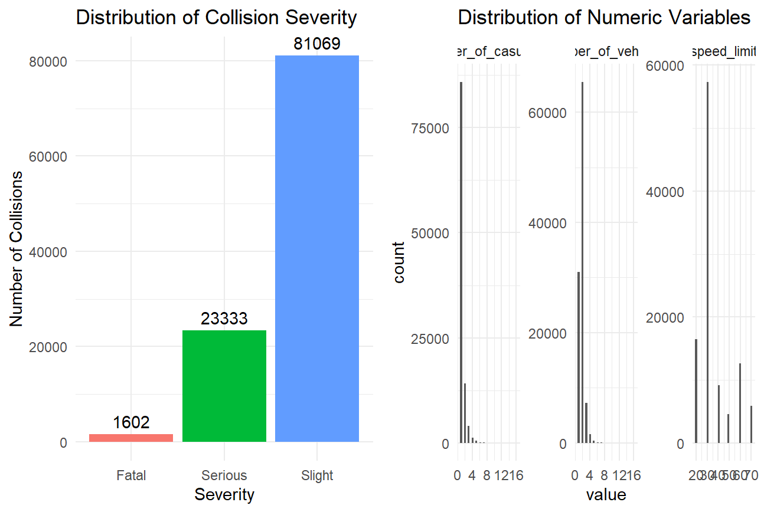
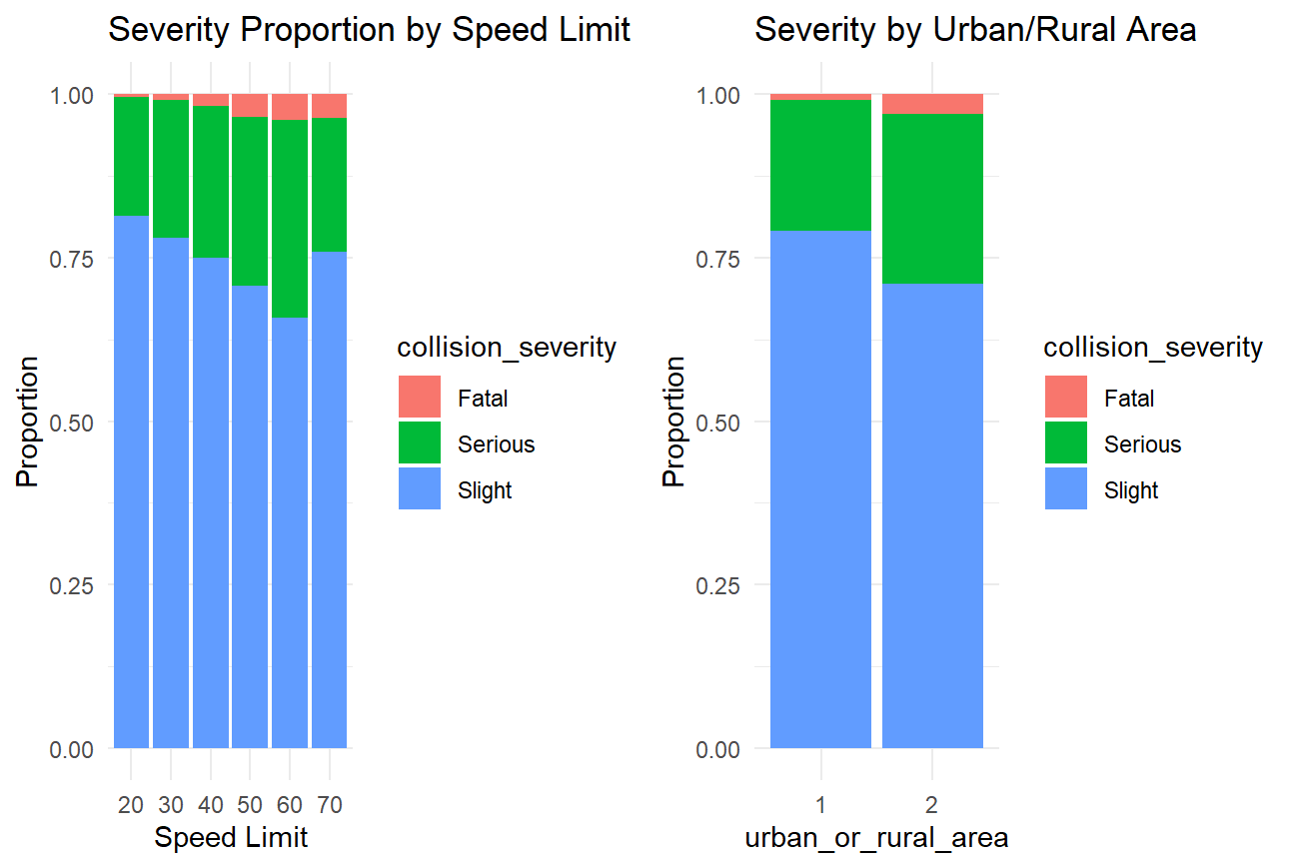
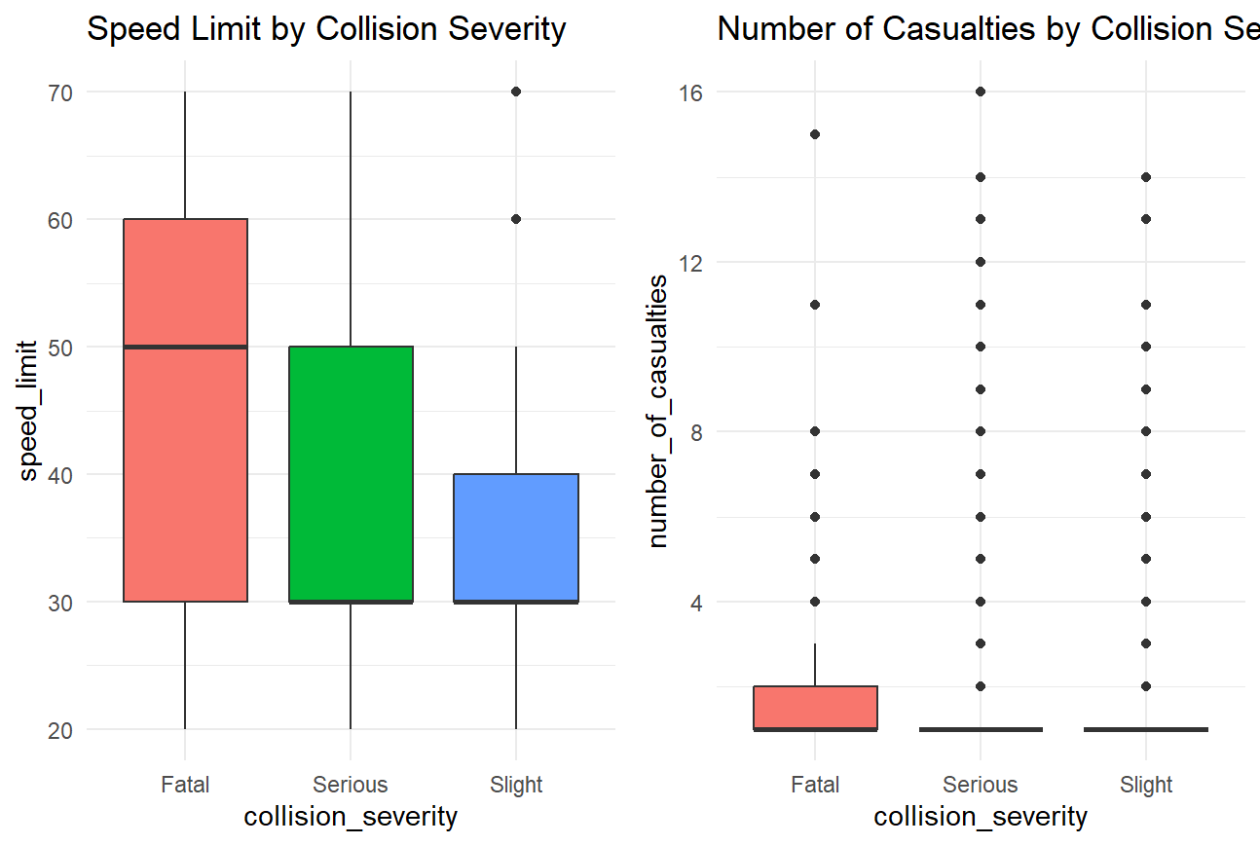
Task 3
06
Descriptive Analysis & Initial Insights
Severity Split:
Fatal: 1.51% | Serious: 22.01% | Slight: 76.48%
Key Patterns:
Higher speed → higher severity
Rural: 3.7x higher fatality than urban
Darkness: highest fatality proportion
Fine weather: most collisions (exposure)
Business Insight:
Target rural, dark, high-speed roads
Numeric Summary:
Mean speed limit: 36.0 mph (median 30)
Mean vehicles per collision: 1.83
Mean casualties per collision: 1.28
IT3081 Statistical Modelling · Consultancy Presentation

Slide 7
Task 4
07
Statistical Inference Evidence
Test | Results | Implication
Chi-square(urban/rural vs severity) | χ² = 1290.3, df = 2, p < 2.2e-16 | Significant association(small effect)
Chi-square: light conditions vs severity | χ² = 917.6, df = 8, p < 2.2e-16 | Significant association
Two-proportion(rural vs urban fatal) | p < 2.2e-16 | Rural 2.99% vs Urban 0.81% fatal
Welch t-test: vehicles, Fatal vs Slight | t = −2.94, df = 1627.8, p = 0.0034 | Significant, small effect (Fatal mean slightly lower)
One-proportion(fatal vs 1%) | p < 2.2e-16 | Observed 1.51% exceeds 1% benchmark
ANOVA(speed – severity) | F = 745.6, p < 2e-16 | Group means differ strongly
Var.test(speed urban vs rural) | F = 0.25, p < 2.2e-16 | Rural speed variance -4× urban
IT3081 Statistical Modelling · Consultancy Presentation

Slide 8
Task 5
08
Predictive Statistical Modelling
Models Compared: Weighted Multinomial Logistic, weighted Ordina logisticl,weighted multinomial LASSO, weighted Elastic Net
Best for interpretation: Weighted Ordinal Logistic (respects Slight < Serious < Fatal ordering; interpretable odds ratios)
Best for screening / minority detection: Weighted LASSO (highest Kappa and Fatal sensitivity, sparse interpretable coefficients)
The Accuracy Illusion:
Unweighted models reach ~76.5% Accuracy — equal to the No Information Rate
Class weights raise Kappa from ≈ 0.008 → 0.085 (≈10×) and Fatal sensitivity from ≈ 0.00 → 0.67
Accuracy alone is misleading on this 76% "Slight" dataset
SMOTE warning: In the sensitivity test, SMOTE collapsed Serious-class sensitivity to 0.0014 — SMOTE is not recommended as the primary fix here.
Recommendation: Ordinal Logistic for interpretation; Weighted LASSO (or Multinomial) for high-risk screening.
Model | Accuracy | Kappa | Macro f1 | Fatal sens | Serious sens | Slight sens | Balanaced acc
Weighted Multinomial | 0.4929 | 0.0841 | 0.3347 | 0.6688 | 0.2820 | 0.5480 | 0.6084
Weighted Ordinal | 0.5217 | 0.0751 | 0.3359 | 0.6271 | 0.2302 | 0.6025 | 0.5985
Weighted LASSO | 0.4969 | 0.0855 | 0.3366 | 0.6688 | 0.2679 | 0.5641 | 0.6087
Weighted Elastic Net | 0.5024 | 0.0844 | 0.3366 | 0.6292 | 0.2842 | 0.5561 | 0.6029
SMOTE Multinomial (sensitivity only | 0.6746 | 0.0737 | 0.3070 | 0.5062 | 0.0016 | 0.8717 | 0.5783
IT3081 Statistical Modelling · Consultancy Presentation

Slide 9
Task 6
09
Experimental Design Evaluation
Possible use of CRD — Randomly assign road segments to different safety treatments when segments are reasonably homogeneous — Standard signage | Speed reduction | Lighting upgrade.
Possible use of RCBD — Block by region / road type and randomise treatments within each block — Urban arterial | Rural single carriageway | Rural high-speed.
Advantages, limitations, and feasibility
CRD: Simple, but less control over confounding road/environmental differences.
RCBD: Better control of variation, but more complex to administer.
Stepped-wedge phased rollout: Most feasible for real-world road safety (aligns with expert validation).
How experiments can support future decisions — Randomised evidence can test which safety strategy performs best across road types and regions, replacing observational inference with causal evidence.
IT3081 Statistical Modelling · Consultancy Presentation

Slide 10
Task 7
10
PCA Evaluation
Evaluating whether PCA provides meaningful dimensionality reduction for the selected numerical predictors.
Need for dimensionality reduction — Only 3 numerical predictors (speed_limit, number_of_vehicles, number_of_casualties) were evaluated using standardised PCA. Weak correlations indicated limited need for reduction.
Possible advantages of PCA — PCA can reduce correlated variables into fewer components and simplify high-dimensional data.
Limitations and risks of PCA — PC1 = 44.31%, PC2 = 30.35%, PC3 = 25.34% variance. Cumulative PC1–PC2 = 74.66%. Principal components are less interpretable than the original variables.
Effect on predictive modelling — PCA provides limited reduction in this dataset, so original variables were retained for better interpretability and policy relevance
Interpretation:
Only 3 numeric predictors → very little to reduce
Loadings show moderate correlation, but no clean grouping into a single dominant factor
Principal components are harder to interpret than the original variables
Conclusion: PCA offers limited benefit here; the original numeric variables were retained for interpretability and policy relevance. PCA is discussed critically as required by the brief, not used in the final models.
IT3081 Statistical Modelling · Consultancy Presentation

Slide 11
Task 8
11
Bayesian Statistical Methods
Critical evaluation of Bayesian alternatives:
Naive Bayes:
Fast, simple, well-suited to classification baselines
Strong conditional-independence assumption is questionable with correlated weather / light / road variables
Bayesian Regression:
Replaces point estimates with full posterior distributions
Naturally quantifies coefficient uncertainty (contrast with LASSO / Elastic Net point estimates)
Can incorporate prior knowledge on rural, high-speed, darkness risk
Bayesian Decision Making:
Combines posterior probabilities with a cost matrix
Highly relevant here — a missed Fatal prediction and a missed Slight prediction have very different real-world costs
Supports threshold-based rules (e.g. dispatch emergency services when P(Fatal) exceeds a threshold)
Trade-off: Greater flexibility and uncertainty quantification, but higher computational cost and more complex to deploy operationally than the current weighted ordinal approach.
IT3081 Statistical Modelling · Consultancy Presentation

Slide 12
Task 9
12
Time Series Extension
Explain how the project could be extended if time-dependent data were available.
Trend analysis opportunities — With multi-year DfT data, collision frequency and severity mix could be monitored across months, seasons and years to evaluate past policy effectiveness.
Seasonal analysis opportunities — Seasonal patterns could be examined across winter/summer and term-time/holiday periods (2022 monthly trend plot already shows month-to-month variation).
Forecasting and ARIMA use — ARIMA or SARIMA could estimate future collision volumes and severity proportions to support resource planning.
Expected business benefits — Forecasting could support early resource planning, intervention scheduling and road safety performance monitoring.
Future Delta — Terms / Years | Trend → Forecast
2022 data already shows ≈25% monthly variation (7,678–9,592), confirming the value of multi-year ARIMA/SARIMA extension.
IT3081 Statistical Modelling · Consultancy Presentation

Slide 13
Task 10
13
Industry Innovation Proposal
A data-driven early-warning framework for proactive road safety support.
Business need — The DfT needs a systematic way to identify high-risk road conditions and prioritise interventions before severe collisions become more frequent.
Proposed Solution — Road Safety Decision Support Dashboard (RSS-DSS)
Collision Data → Weighted Ordinal Logistic (interpretation) + Weighted LASSO (screening) → Predicted Severity Risk → Analyst Review → Targeted Intervention
Expected benefits and required resources — Earlier identification of high-risk segments, evidence-based resource allocation and improved monitoring. Requires collision data, weather/traffic feeds, secure database, statistical model, dashboard and analyst involvement.
Implementation challenges and organizational impact — Data privacy, data quality, false predictions and staff training must be managed. Supports analysts and emergency services without replacing human judgement.
IT3081 Statistical Modelling · Consultancy Presentation

Slide 14

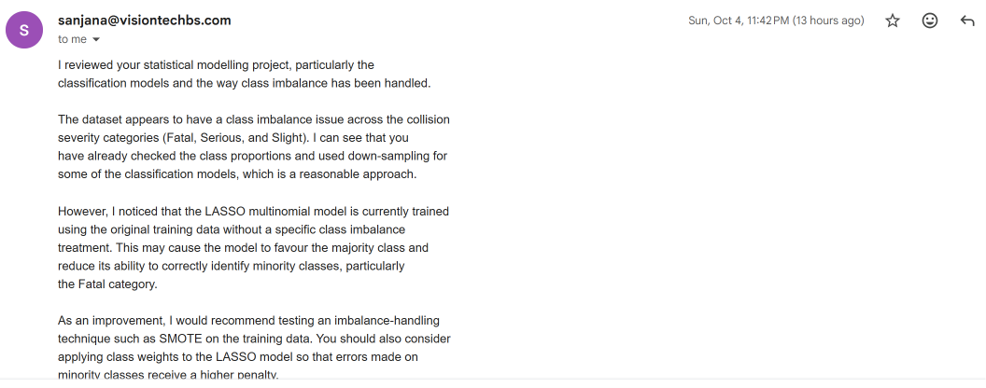
Task 11
14
Industry Expert Validation
Area | Expert Comment
Relevance | Class imbalance across Fatal/Serious/Slight is a real, material problem
Practicality | LASSO should be imbalance-treated; test SMOTE and/or class weights
Feasibility | Compare models using class-level sensitivity, Macro F1, and confusion matrix — not accuracy alone
Organizational Impact | Model must correctly identify minority (Fatal) class, not just maximize overall accuracy
Expert Recommendation Our Action
Handle class imbalance explicitly Inverse-frequency class weights applied to all 4 models
Apply class weights to LASSO Verified — weights = train_weights passed to cv.glmnet
Test SMOTE on training data Ran as sensitivity analysis → Serious-class
Use class-level metrics, not accuracy Adopted — Sensitivity, Macro F1, Kappa, Balanced Accuracy reported for all models
IT3081 Statistical Modelling · Consultancy Presentation

Slide 15
Task 12
15
Final Consultancy Recommendations
Strategic:
Establish a data-driven Road Accident Severity Prediction Framework using Weighted Ordinal Logistic Regression as the interpretable core model, supported by Weighted LASSO as a high-risk screening tool.
Operational:
Monitor key indicators: speed limit, rural location, light conditions, number of vehicles, weekend status
Analyst-led review of high-risk segments
Retrain the production model with class weights — this raises Kappa from ≈ 0.008 to ≈ 0.085 and Fatal sensitivity from ≈ 0.00 to ≈ 0.67
Do not use SMOTE as the primary fix — the sensitivity test collapsed Serious-class sensitivity to 0.0014
Risk Management & Ethics:
Protect collision-data privacy (GDPR)
Maintain data quality and monitor for drift
Document the modest Kappa (≈ 0.08) transparently as the honest ceiling for a 3-class severity model on this data
Use predictions as decision support, not automatic decisions
Future Research & Next Steps:
Validate the framework with road-safety experts
Collect multi-year longitudinal data
Apply ARIMA/SARIMA forecasting to monthly severe-collision volumes
Evaluate interventions via stepped-wedge trials
Explore Bayesian methods where prior information and cost-sensitive decisions matter
IT3081 Statistical Modelling · Consultancy Presentation

